Slide 1
Programming Basic 1 Keywords and Data Types

Slide 2
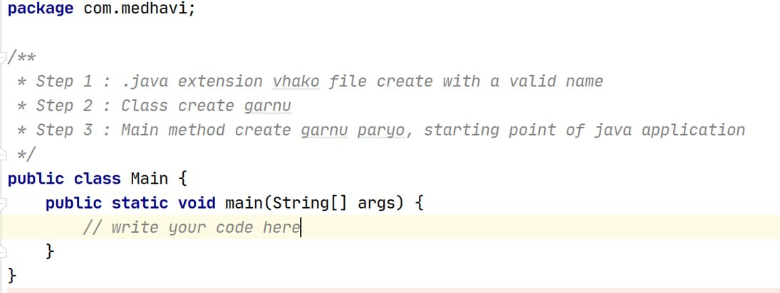
Java Class
com.test

Slide 3
Class & Objects
Template of methods and variables associated with an object
Class - describes the behaviour/state that object supports
Object - an instance of a class
Object - real world entity with an implementation of the class

Slide 4
Class Naming Convention
Names should be in CamelCase
Should use nouns because it represents real world objects
Example
Student
Teacher
TeacherDepartment

Slide 5
Methods
Block of code which consists of business logic
It gets executed or runs whenever it is called
Important ?
Reusability
Better understanding flow
To be discussed later
Parameters
Variables inside the method
Arguments
Values passing to the method parameter is the argument

Slide 6
Method Naming Convention
Should be verbs
First letter will of the name is in lowercase and each new word begins with a capital letter (Camel Case)
Also called Mixed Case Convention
Example
addSalary()
getName()

Slide 7
Comments
Add human readable notes to source code
Can be for future reference
Todo task list
Flow understanding
HIde source code without deleting
Line comment -> //
Text ignored until end of current line
Block Comment
/* …….. */
Text ignored within the block, can be multiple line
Javadoc comment
/** …*/
Compiler treats similar to block comment
Can be used to generate document

Slide 8
Packages
Grouping of classes
Follow standard naming convention
Affect source code structure
Naming conventions
All lowercase
Add uniqueness through the name of group or company
com is used by companies followed by company name
Eg : com.sun
org is used by non-profit organizations for open source code
Eg : org.w3c

Slide 9
Keywords
Keywords are predefined, reserved words used in Java programming that have special meanings to the compiler.
public class Test;
Here, int is a keyword. It indicates that the variable score is of integer type (32-bit signed two's complement integer).

Slide 10
Java Keywords List
abstract | assert | boolean | break | byte
case | catch | char | class | const
continue | default | do | double | else
enum | extends | final | finally | float
for | goto | if | implements | import
instanceof | int | interface | long | native
new | package | private | protected | public
return | short | static | strictfp | super
switch | synchronized | this | throw | throws
transient | try | void | volatile | while

Slide 11
Identifiers
Identifiers are the name given to variables, classes, methods etc.
int score;
class Student
getStudent()
Here, score is a variable (an identifier). You cannot use keywords as variable name. It's because keywords have predefined meaning.

Slide 12
Rules for naming an identifier
Identifier cannot be a keyword.
Identifiers are case-sensitive.
It can have a sequence of letters and digits. However, it must begin with a letter, $ or _. The first letter of an identifier cannot be a digit.
It's convention to start an identifier with a letter rather and $ or _.
Whitespaces are not allowed.
Similarly, you cannot use symbols such as @, #, and so on.

Slide 13
Literals
Any constant value which can be assigned to the variable is called as literal/constant.
Boolean literals - true and false
Integer literals - binary, octal, hexadecimal
Floating-point literals - decimal values like 3.4,3.5
Character literals - ‘a’ , ‘x’
String literals - ‘Ram’ , ‘Java’

Slide 14
Data Types
Provides different values and its size to store in a variable
Two types
Primitive data type :
Predefined by Java
Cannot contain null
int, long, boolean, char
Non-primitive data types :
Are not predefined, defined by programmers
Contains null
Classes, interfaces, Arrays

Slide 15
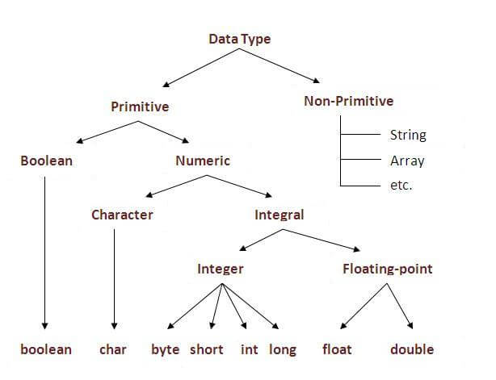
Data Types

Slide 16
Primitive Data Types
Data Type | Default Value | Default size
boolean | false | 1 bit
char | '\u0000' | 2 byte
byte | 0 | 1 byte
short | 0 | 2 byte
int | 0 | 4 byte
long | 0L | 8 byte
float | 0.0f | 4 byte
double | 0.0d | 8 byte

Slide 17
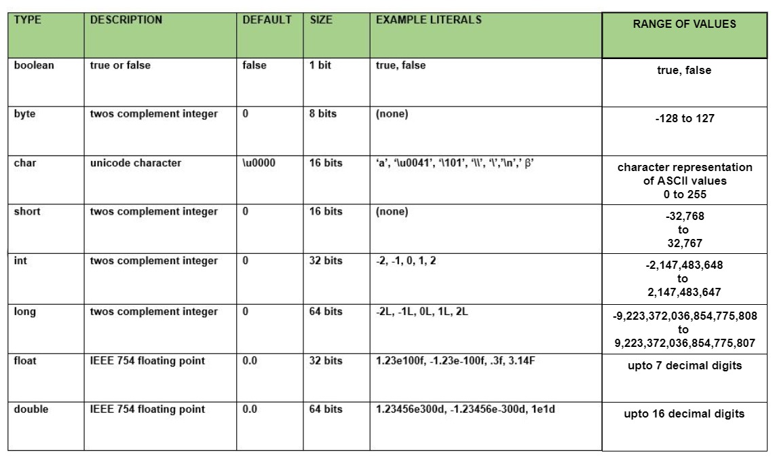
Primitive Data Types

Slide 18
Non-Primitive Data Types
Refers to objects
Value can be null
Do not store value of a variable directly in memory, stores a memory address of the variable
Non-Primitive Data Types
Classes
String
Array
Interface

Slide 19
Variables
A variable is the name given to a memory location. It is the basic unit of storage in a program.
The value stored in a variable can be changed during program execution.
A variable is only a name given to a memory location, all the operations done on the variable effects that memory location.
In Java, all the variables must be declared before they can be used.
Naming convention
User only letters and numbers
First character cannot be number
Use camel case convention
Start each word after the first with upper case
All other letters are camelCase

Slide 20
Variables
Although Java is object oriented, not all types are objects. It is built on top of basic variable types called primitives.
Here is a list of all primitives in Java:
byte (number, 1 byte)
short (number, 2 bytes)
int (number, 4 bytes)
long (number, 8 bytes)
float (float number, 4 bytes)
double (float number, 8 bytes)
char (a character, 2 bytes)
boolean (true or false, 1 byte)

Slide 21
Type of Variables

Slide 22
Type of Variables
1) Local Variable
A variable declared inside the method is called local variable.
2) Instance Variable
A variable declared inside the class but outside the method, is called instance variable . It is not declared as static.
3) Static variable
A variable which is declared as static is called static variable. It cannot be local.

Slide 23
Example of Variables
class A{
int data=50;//instance variable
static int m=100;//static variable
void method(){
int n=90;//local variable
}
}//end of class

Slide 24
Local Variables
Local variables are declared in methods, constructors, or blocks.
Local variables are created when the method, constructor or block is entered and the variable will be destroyed once it exits the method, constructor, or block.
Access modifiers cannot be used for local variables.
Local variables are visible only within the declared method, constructor, or block.
Local variables are implemented at stack level internally.
There is no default value for local variables, so local variables should be declared and an initial value should be assigned before the first use.

Slide 25
Instance Variables
Instance variables are declared in a class, but outside a method, constructor or any block.
When a space is allocated for an object in the heap, a slot for each instance variable value is created.
Instance variables are created when an object is created with the use of the keyword 'new' and destroyed when the object is destroyed.
Instance variables hold values that must be referenced by more than one method, constructor or block, or essential parts of an object's state that must be present throughout the class.
Instance variables can be declared in class level before or after use.
Access modifiers can be given for instance variables.
The instance variables are visible for all methods, constructors and block in the class. Normally, it is recommended to make these variables private (access level).
Instance variables have default values. For numbers, the default value is 0, for Booleans it is false, and for object references it is null. Values can be assigned during the declaration or within the constructor.
Instance variables can be accessed directly by calling the variable name inside the class. However, within static methods (when instance variables are given accessibility), they should be called using the fully qualified name. ObjectReference.VariableName.

Slide 26
Static Variables
Class variables also known as static variables are declared with the static keyword in a class, but outside a method, constructor or a block.
There would only be one copy of each class variable per class, regardless of how many objects are created from it.
Static variables are rarely used other than being declared as constants. Constants are variables that are declared as public/private, final, and static. Constant variables never change from their initial value.
Static variables are stored in the static memory. It is rare to use static variables other than declared final and used as either public or private constants.
Static variables are created when the program starts and destroyed when the program stops.
Visibility is similar to instance variables. However, most static variables are declared public since they must be available for users of the class.
Default values are same as instance variables. For numbers, the default value is 0; for Booleans, it is false; and for object references, it is null. Values can be assigned during the declaration or within the constructor. Additionally, values can be assigned in special static initializer blocks.
Static variables can be accessed by calling with the class name Class Name. Variable Name.
When declaring class variables as public static final, then variable names (constants) are all in upper case. If the static variables are not public and final, the naming syntax is the same as instance and local variables.

Slide 27
Declaration and Initialization
Declaration, generally, refers to the introduction of a new name in the program.
Initialization refers to the "assignment" of a value, at construction time.

Slide 28
Declaration and Initialization
int a, b, c; // Declares three ints, a, b, and c.
int a = 10, b = 10; // Example of initialization
byte B = 22; // initializes a byte type variable B.
double pi = 3.14159; // declares and assigns a value of PI.
char a = 'a'; // the char variable a iis initialized with value 'a'

